Slide 1


Morphology and Word Formation in Natural Languages
SIMATS ENGINEERING
Saveetha Institute of Medical and Technical Sciences Chennai-602105.
DSA0304 Natural Language Processing
Candidate:
B Jaswanth(192472251)
Guide by:
Dr T Devi

Slide 2


Morphology
What is Morphology?
Morphology is the study of the internal structure of words.
It explains how words are formed from smaller meaningful units called morphemes.
Morphology helps us understand word meaning, grammatical function, and word relationships.
Example:
unhappiness = un- + happy + -ness

Slide 3
Morphemes and Their Types
Derivational Morphemes: create new words
happy → happiness
Inflectional Morphemes: change grammatical form
play → played, cat → cats
Free Morphemes: can stand alone as words
Example: book, run, happy
Bound Morphemes: cannot stand alone, must attach to another morpheme
Example: un-, -ed, -s, -ness

Slide 4
Word Formation Processes
Common ways words are formed in natural languages:
Affixation: adding prefixes/suffixes
unhappy, teacher
Compounding: combining two words
blackboard, smartphone
Conversion: changing word class without changing form
email (noun) → email (verb)
Blending: combining parts of words
smog = smoke + fog
Clipping: shortening a word
lab = laboratory

Slide 5
Importance of Morphology in NLP
Morphology is important in Natural Language Processing (NLP) because it helps systems:
Understand word meaning
Recognize different word forms
Perform stemming and lemmatization
Improve machine translation
Support information retrieval and search
Handle richly inflected languages like Tamil, Hindi, Arabic, etc.
Example:
play, plays, playing, played → all related to the root play

Slide 6
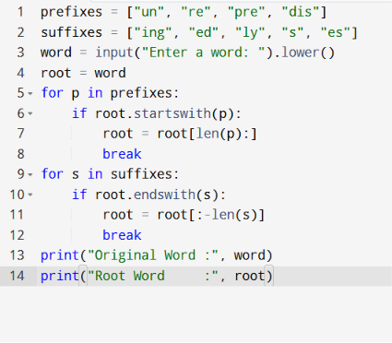

Implementation

Slide 7
Thank You

